Slide 1
OOP part 2
Dr. Ahmad Altarawneh

Slide 2
Encapsulation
Encapsulation is one of the fundamental concepts in object-oriented programming (OOP) that promotes the idea of combining data (attributes) and methods (functions) that operate on the data within a single unit (the class).
It helps hide an object's internal state and implementation details from the outside while providing a controlled way to access and modify the object's data.
Python does not have strict rules for encapsulation, it is a convention more than an enforcement
Access modifiers in python include:
The default access modifier is Public
Protected can be achieved by prefixing the attribute or the method with _
Private can be achieved by prefixing the attribute or the method with _ _ Python

Slide 3
Cont.
Protected means that this attribute (or method) can be accessed from the class and its subclasses
private means the attribute can be accessed within the class, not from anywhere outside the class
Remember: in Python, it is just a convention, the attributes and methods can still be accessed from outside with some effort (name mangling)
name mangling is the method Python uses internally to change the name of the variable to make it less accessible from outside the class

Slide 4
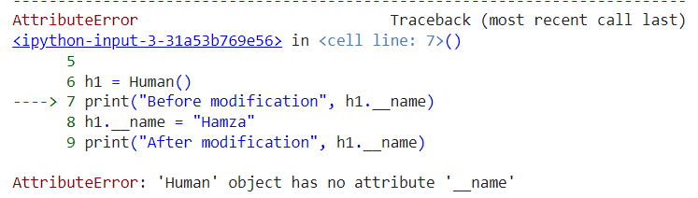
Example
class Human:
def __init__(self):
self.name = "Ahmad"
h1 = Human()
print("Before modification", h1.name)
h1.name = "Hamza"
print("After modification", h1.name)
class Human:
def __init__(self):
self.__name = "Ahmad"
h1 = Human()
print("Before modification", h1.__name)
h1.__name = "Hamza"
print("After modification", h1.__name)
Before modification Ahmad
After modification Hamza

Slide 5
Name mangling
class Human:
def __init__(self):
self.__name = "Ahmad"
h1 = Human()
print("Before modification", h1._Human__name)
h1._Human__name = "Hamza"
print("After modification", h1._Human__name)
Before modification Ahmad
After modification Hamza
Although it is defined as private, we still can access it
object._ClassName.__variableName

Slide 6
Cont.
The good practice is to access private variables through getters and setters
Why?
This allows to add and modify the implementation as needed
Example: assume that I have an attribute called balance, which represents the balance of a customer at a bank
Imagin, you want to modify this attribute's value after a withdrawal process
using a setter, we can ensure that the new value is validated before it modifies the balance (the new balance is not a negative number)

Slide 7
class BankAccount:
def __init__(self, initial_balance=0):
self._balance = initial_balance
def get_balance(self):
return self._balance
def set_balance(self, new_balance):
if new_balance >= 0:
self._balance = new_balance
acc = BankAccount()
acc._balance = -10
When we do acc._balance = -10, we are directly modifying the _balance attribute without using the set_balance method.
Consequently, you're bypassing the validation check inside the set_balance method.

Slide 8
Method types
In python OOP there are 3 main types of methods:
regular method: these methods belong to the objects and takes self as their first argument.
These methods can change the object state
class method: these methods belong to the class and takes cls as their first argument.
These methods can change the class state
static methods: The method does not belong to the class or the object, but performs related functionality of some sort

Slide 9
Regular method
class Student:
def __init__(self, name):
self.name = name
def say_hello(self):
print(f"Hello, my name is {self.name}!")
obj = Student("Jawad") obj.say_hello()
We can access the method say_hello through an object, and it makes the object (which calls the method) to perform an action (saying his name)

Slide 10
Class method
class Student:
num_of_students = 0
def __init__(self, name):
self.name = name
Student.add_student()
def say_hello(self):
print(f"Hello, my name is {self.name}!")
@classmethod
def add_student(cls):
cls.num_of_students += 1
@classmethod
def get_num_students(cls):
return cls.num_of_students
obj1 = Student("Jawad")
obj2 = Student("maher")
Student.get_num_students()
In this example the class method add_student is responsible for incrementing the class variable num_of_students whenever a new object is created
class method takes the class as its first argument (cls)
@classmethod is called a decorator, it is responsible for changing the behavior of the method

Slide 11
This code will give an error
This is because the variable num_of_students is considered as a local for the function add_student
local variable 'num_of_students' referenced before assignment
class Student:
num_of_students = 0
def __init__(self, name):
self.name = name
Student.add_student()
def say_hello(self):
print(f"Hello, my name is {self.name}!")
def add_student():
num_of_students += 1
obj = Student("Jawad")
Student.add_student()

Slide 12
Cont.
Class methods can be called using the class name as well as any instance created from the class
obj.add_student()
Student.add_student()
print (obj.num_of_students)
class Student:
num_of_students = 0
def __init__(self, name):
self.name = name
Student.add_student()
@classmethod
def add_student(cls):
cls.num_of_students += 1
obj = Student("Jawad")
Such behavior will cause an issue, the number of students can be increased even without creating a new object (just by calling the method from any object
In this scenario, make sure you call the method just inside the constructor

Slide 13
Static method
Static methods in Python are similar to regular functions but are defined within a class because they have a logical connection to the class
Assume that you want to create a class that consists of methods that operate on numbers (multiply, add, subtract)
Such methods do not require an object to be called, they can be called directly from the class
we add them in a class for several reasons
Easier to read
very good for organization: all the related functionality are called using one name space

Slide 14
Cont.
To write a static method we use the decorator @staticmethod
class Math:
@staticmethod
def add(x, y):
return x + y
@staticmethod
def subtract(x, y):
return x – y
@staticmethod
def multiply(x, y):
return x * y
Math.add(5,6)

Slide 15
Cont.
Even when the static method is not defined explicitly using the decorator, the method will behave as a static method (does not rely of instance (self) or class (cls) data.
BUT cannot be called from instances of that class anymore
class Math:
def add(x, y):
return x + y
def subtract(x, y):
return x - y
def multiply(x, y):
return x * y
def divide(x, y):
if y == 0:
return "Cannot divide by zero"
return x / y
Math.add(5,6)

Slide 16
Cont.
In the previous case the methods cannot be called from instances of class math
try to create an object and call the method add()
If you want them to be invoked by instances of the class Math, you have to decorate them with @staticmethod
if you have a class variable and you want to access it inside these functions, then you have to decorate them with @classmethod decorator

Slide 17
Cont.
The add method works here
In this case the method is not decorated with static class decorators. So python treats mmm as a self, and through it has access to the class and instance variables
add now is an instance method (regular)
class Math:
const = 2
def add(mmm, x, y):
return x + y + mmm.const
…. # Call the add method
m = Math()
m.add(5, 6)

Slide 18
Cont.
A class can have both regular and static method at the same time
Take a look at the following KNN class
class KNN:
def __init__(self):
pass
def fit(self):
pass
def predict(self):
pass
@staticmethod
def getScore(actual, predicted):
# this is a static method helps in calculating the accuracy,
#given the actual and predicted values

Slide 19
Summary
Aspect | Instance Method | Class Method | Static Method
Decorator | No decorator needed | @classmethod decorator | @staticmethod decorator
Access to instance | Has access to instance attributes | Doesn't have access to instance data | Doesn't have access to instance data
Access to class | Has access through self parameter | Has access through cls parameter | No direct access to class or instance
Usage | Used for operations on instance | Used for operations on class | Independent operations
Invocation | Called on instances of the class | Can be called on class or instances | Can be called on class or instances
Parameter Convention | Takes self as first parameter | Takes cls as first parameter | Doesn't take cls or self (takes parameters like traditional functions)
Use Cases | Work with instance-specific data | Work with class-level data | Utility functions independent of both

Slide 20

Inheritance

Slide 21
Inheritance
Inheritance is an important OOP principle that helps in code reusability
It allows a class to inherit properties and behavior (attributes and methods) from another class, known as the base class or parent class.
The class that inherits from the base class is called the derived class or child class.
In python there are several types of inheritance:
Single Inheritance: one class inherits another class.
Multiple Inheritance: In this type, a derived class can inherit from multiple base classes
Multilevel Inheritance: This type involves a chain of inheritance where a derived class acts as a base class for another class.
Hierarchical Inheritance: Multiple classes are derived from a single base class.

Slide 22
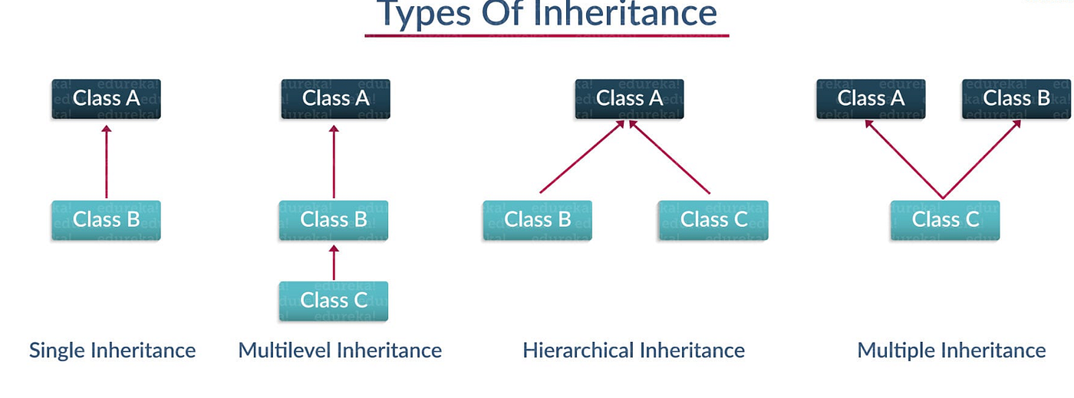
Types of inheritance

Slide 23
Examples (single)
class Animal:
def __init__(self, name):
self.name = name
class Dog(Animal):
def __init__(self, name, num_legs):
super().__init__(name)
self.num_legs = num_legs
def printInfo(self):
print(f"This is {self.name}, I have {self.num_legs} legs")
d = Dog("TOM",4)
d.printInfo()

Slide 24
Examples (multiple)
class A:
def method_a(self):
print("This method in the class A")
class B:
def method_b(self):
print("This method in the class B")
class C(A, B):
def method_c(self):
print("This method in the class C")
h = C()
h.method_a()
h.method_b()
This method in the class A
This method in the class B

Slide 25
Overriding
Method overriding is an OOP principle that makes the subclass have a specific implementation of a method that is defined in the superclass
Assume that we have a class called Shape, the shape has:
X and Y locations
size
Also, has the methods:
move: the shape has a bouncing movement around the canvas
show: The shape show itself, by default, as a circle

Slide 26
class Shape: def __init__(self, x , y): self.x = x self.y = y self.size = 50 self.xspeed = 1 self.yspeed = 1
def move(self): self. x += self.xspeed def show(self): ellipse(self.x, self.y, self.size, self.size)

Slide 27
Square class
Now we have another class called square, which inherits attributes from the superclass but takes an additional parameter, which is the side length
The square shows itself as a square (overrides the draw method in the superclass)
class Square(Shape): def __init__(self, x, y, side_len): super().__init__(x, y) self.side_len = side_len def show(self): rect(self.x, self.y,self.side_len,self.side_len)

Slide 28
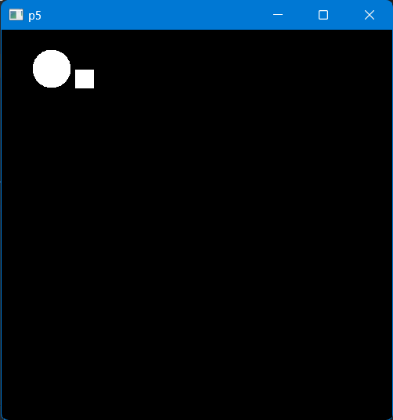
Main loop
def setup(): size(500,500) shape1 = Shape(20,50) square1 = Square(50,50,25) def draw(): background(0) shape1.move() shape1.show() square1.move() square1.show()

Slide 29
Explanation
In the previous example, we override the method show, so it works differently in the subclass Square
All other methods and attributes are inherited from the superclass, keeping their default implementation and values
Attributes can be overridden as well.
For example, you might want the speed for the squares to be faster than other shapes, so you assign a new value for the speed inside the square constructor
def __init__(self, x, y, side_len): super().__init__(x, y) self.xspeed = 10 self.side_len = side_len
re run and check the difference

Slide 30
Polymorphism
Polymorphism means many forms or many shapes.
You can also as many behaviors, like the same function behaves differently depending upon its input
For example, let consider the len function
when you pass a String, it gives the number of letters
when you pass a list of string values ( ['Ahmad', 'Samer']) it gives the number of items
when you pass a dictionary, it gives the number of key,value pairs
This is a kind of polymorphism

Slide 31
Polymorphism with classes
Assume that we have two classes one called Shape
shape shows itself by default as a point and move horizontally
Also, we have a triangle, which inherits the class Shape
However, we want the triangle to behave differently
show itself as a triangle
move in a circular motion
let us implement this using P5

Slide 32
Shape class
import random from p5 import * class Shape: def __init__(self, x , y): self.x = x self.y = y self.size = 20 self.xspeed = 1 self.yspeed = 1 def move(self): self. x += self.xspeed def show(self): ellipse(self.x, self.y, self.size, self.size)

Slide 33
Triangle class
class Triangle(Shape): def __init__(self, x, y): super().__init__(x, y) self.angle = 0 def show(self): stroke(255) line(self.x, self.y,self.x+self.size, self.y) line(self.x, self.y, self.x + self.size/2 , self.y+self.size) line(self.x+self.size, self.y, self.x + self.size/2 , self.y+self.size) def move(self): self.angle += 0.05 radius = 5 self.x = self.x + radius * cos(self.angle) self.y = self.y + radius * sin(self.angle)

Slide 34
Main
def setup(): size(600,600) shapes =[] for i in range(10): randx = random.randint(0,width) randy = random.randint(0,height) if random.uniform(0,1) < 0.5: shapes.append(Triangle(randx,randy)) else: shapes.append(Shape(randx,randy)) def draw(): background(0) for i in shapes: i.show() i.move() if __name__=="__main__": run()

Slide 35
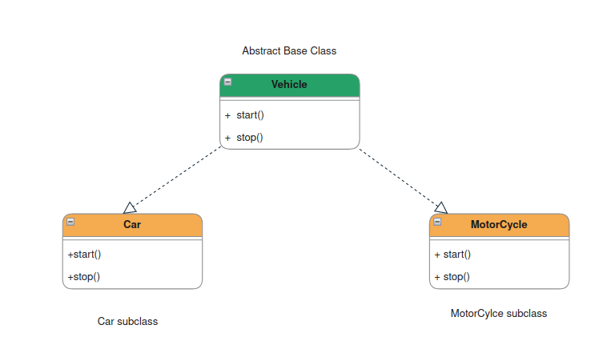
Abstraction
The implementation we have done for the shape class might not be the best possible implementation
The better way is to make the Shape class ABSTRACT and override its method in the subclasses
What do we mean by abstract class and abstraction?

Slide 36
Cont.
Abstraction in Python OOP aims to hide the implementation and make a super class as an interface of other classes (subclasses)
Originally, python does not have a built-in mechanism for abstract class, it provides it through a module called abc using Abstract Base classes(ABC).
Example:
Assume that you want to create an abstract class called Shape
from abc import ABC, abstractmethod
class Shape(ABC):
@abstractmethod
def area(self):
pass
@abstractmethod
def perimeter(self):
pass

Slide 37
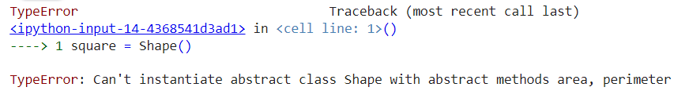
Cont.
Abstract class cannot be instantiated, cannot create objects belong to abstract class
The class is called an abstract class if it has one abstract method, at least.
Also, the abstract class can have a method with implementation
These methods are called concrete methods
their implementation can be overridden in the subclass(es)
shape = Shape()

Slide 38
Cont.
Follows is an abstract class Shape with a concrete method called description
from abc import ABC, abstractmethod
class Shape(ABC):
@abstractmethod
def area(self):
pass
def description(self):
return "This is a shape."
class Square(Shape):
def __init__(self, side):
self.side = side
def area(self):
return self.side ** 2

Slide 39
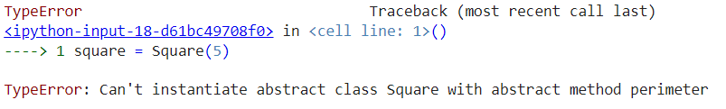
Cont.
All abstract methods in the abstract class MUST be implemented in the subclass, otherwise python will raise an error
@abstractmethod
The decorator is compulsory here: it enforces the subclasses to implement these methods

Slide 40
Example
Let us try to define a Shape class, which is an abstract class.
it defines the functionality that should be implemented in the subclasses
import random
from abc import ABC, abstractmethod
import pygame as pg
class Shape(ABC):
def __init__(self, x, y):
self.x = x
self.y = y
self.xspeed = random.randint(2, 6)
self.yspeed = random.randint(2, 6)
self.size = random.randint(10, 30)
@abstractmethod
def show(self, screen):
pass
@abstractmethod
def move(self):
pass

Slide 41
Actual shapes
Now we want actual shape classes, we want to add
Point class, which inherits the abstract class Shape
Square class, which inherits the abstract class Shape
Each of these classes must provide implementation for the abstract methods in the super class

Slide 42
Point
class Point(Shape):
def __init__(self, x, y):
super().__init__(x, y)
def show(self, screen):
pg.draw.circle(screen, (255, 0, 0), (self.x, self.y), self.size)
def move(self, screen):
self.x += self.xspeed
self.y += self.yspeed
if self.x < 0 or self.x > screen.get_width() - self.size:
self.xspeed = -self.xspeed
if self.y < 0 or self.y > screen.get_height() - self.size:
self.yspeed = -self.yspeed

Slide 43
Square
class Square(Shape):
def __init__(self, x, y):
super().__init__(x, y)
def show(self, screen):
pg.draw.rect(screen, (0, 0, 255), (self.x, self.y, self.size, self.size))
def move(self,screen):
self.x += self.xspeed
self.y += self.yspeed
if self.x < 0 or self.x > screen.get_width() - self.size:
self.xspeed = -self.xspeed
if self.y < 0 or self.y > screen.get_height() - self.size:
self.yspeed = -self.yspeed

Slide 44
Main pygame loop
for this we will use the pygame as it is much faster than many of other visualization packages
pygame application contains a main loop, that repeatedly executes a set of operations
animation draws
events (e.g., mouse and keyboard events)
to create a pygame app we follow the following steps
See next slide

Slide 45
it initializes several internal
modules within Pygame, such
as display, sound, fonts, joystick, and more,
depending on what features are available
in your system
import sys
import pygame as pg
pg.init()
screen = pg.display.set_mode((600,600))
clock = pg.time.Clock()
running = True
while running:
screen.fill((255, 255, 255))
for event in pg.event.get():
if event.type == pg.QUIT:
running = False
#YOUR ANIMATION (code) MIGHT GO HERE pg.display.flip()
clock.tick(60)
pg.quit()
sys.exit()
import the pygame package
import the pygame package
Initialize the main screen size
Initialize clock to control the frame rate
variable to control the loop
fill the screen with a background color: here is white
Check all the happening events during the execution time.
here we check for one event: if we press the QUIT the loop
will stop execution (by turning the running to false)
flip is used to update the screen: it is like redraw
the tick here is to control the frame rate: it says 60 frames per second
Exit the application after the while loop termination

Slide 46
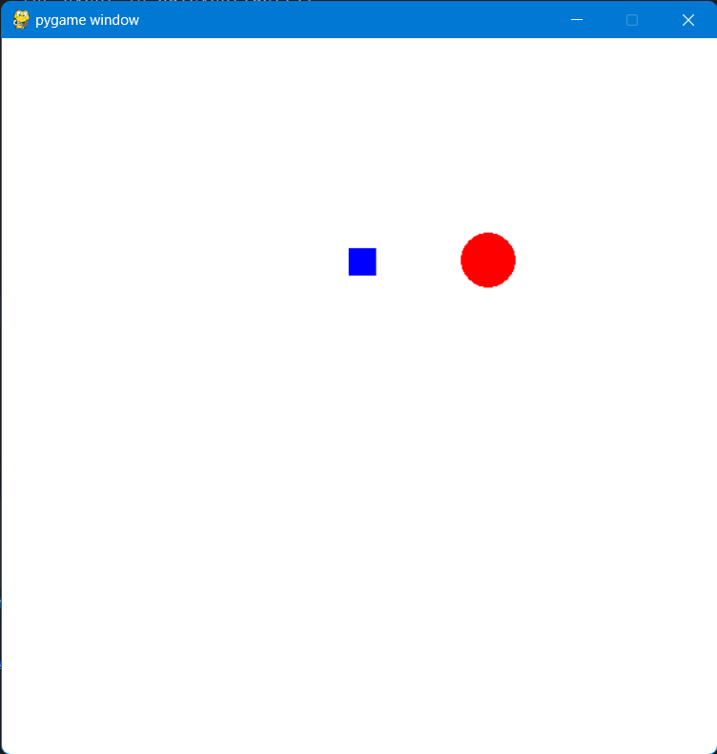
Combine the code
import sys
import pygame as pg
from utility import *
pg.init()
screen = pg.display.set_mode((600,600))
clock = pg.time.Clock()
p = Point(20,20)
s = Square(30,30)
running = True
while running:
screen.fill((255, 255, 255))
for event in pg.event.get():
if event.type == pg.QUIT:
running = False
p.show(screen)
p.move(screen)
s.show(screen)
s.move(screen)
pg.display.flip()
clock.tick(60)
pg.quit()
sys.exit()

Slide 47
Add Shapes as you click the mouse
import random
import sys
import pygame as pg
from utility import *
pg.init()
screen = pg.display.set_mode((600,600))
clock = pg.time.Clock()
shapes = []
running = True
while running:
screen.fill((255, 255, 255))
for event in pg.event.get():
if event.type == pg.QUIT:
running = False
if event.type == pg.MOUSEBUTTONDOWN:
if random.randint(0,100) < 20:
shapes.append(Point(10,10))
else:
shapes.append(Square(10, 10))
for s in shapes:
s.move(screen)
s.show(screen)
pg.display.flip()
clock.tick(60)
pg.quit()
sys.exit()

Slide 48
Benefits of OOP
Modularity and Reusability: Breaks down complex problems into manageable objects, promoting reusability and reducing redundancy.
Encapsulation: Hides internal implementation details, enhancing security and controlling access to data.
Easier Maintenance: Modular nature makes it easier to update and maintain code without affecting the entire program.
Better Collaboration: Organizes code with classes, methods, and interfaces, facilitating collaboration among developers.

Slide 49
Particle system using pygame (Full example)
Let us take a full example of how to develop our last Shapes and turn it to a full particle system
Particle system consists of a set of small objects, called particles, that typically move, behave, and interact in an organized manner
Particles in the particle system can response to physical changes
Let us try to build one
Start from the next slide

Slide 50
Particle class
class Particle: def __init__(self, x, y): self.x = x self.y = y self.xspeed = random.uniform(-1, 1) self.yspeed = random.uniform(-2, -3) self.size = random.randint(5, 15) self.life_time = 300 self.accelaration = [0,0] def show(self, screen): pg.draw.circle(screen,(255,0,0),(self.x, self.y),self.size) def move(self): self.x += self.xspeed self.y += self.yspeed self.xspeed += self.accelaration[0] self.yspeed += self.accelaration[1] self.accelaration[0] = 0 self.accelaration[1] = 0 self.life_time -= 3 def applyForce(self, force): self.accelaration[0] += force[0] self.accelaration[1] += force[1]

Slide 51
Particle System class
class ParticleSystem(): def __init__(self, x, y): self.particles = [] self.x = x self.y = y def update(self): self.particles.append(Particle(self.x,self.y)) def display(self, screen, force): for particle in self.particles: particle.applyForce(force) particle.move() particle.show(screen) if particle.life_time <0: self.particles.remove(particle)

Slide 52
Main loop (main application)
import random import sys import pygame as pg import numpy as np from utility import * pg.init() screen = pg.display.set_mode((800,800)) clock = pg.time.Clock() parSystems = [] running = True force = [0.0, 0.0]
def map_value(mx, in_min, in_max, out_min, out_max): return (mx - in_min) * (out_max - out_min) / (in_max - in_min) + out_min
while running: screen.fill((255, 255, 255)) for event in pg.event.get():
if event.type == pg.QUIT: running = False if event.type == pg.MOUSEBUTTONDOWN: psx,psy = pg.mouse.get_pos() parSystems.append(ParticleSystem(psx,psy)) mx, my = pg.mouse.get_pos() windx = map_value(mx,0,800,-1,1) force[0] = windx for psys in parSystems: psys.update() psys.display(screen,force) pg.display.flip() clock.tick(60) pg.quit() sys.exit()

